Slide 1
YouTube Video Analysis
Team members:
Pooja Laveti
Vamshi Krishna Timberiveni
Jael Kruthi Battana

Slide 2
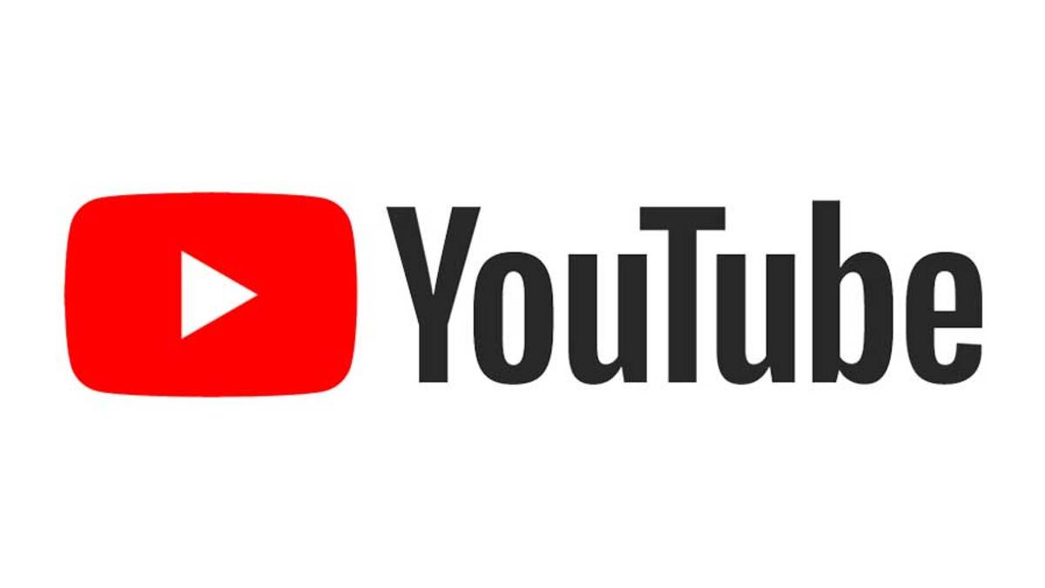
Introduction
YouTube is an online platform where users can watch, share, like, comment on, and subscribe to videos created by content creators. The number of views, likes, and the age of the video are used to determine which videos are included in YouTube's trending video category.
The main challenge for content creators, in this case, is analyzing the factors that influence popular YouTube videos.
So, the project is chosen to assist content creators in maximizing their video creativity by following the necessary recommendations.

Slide 3
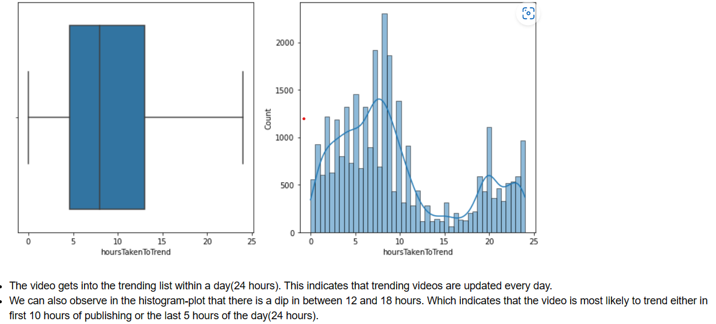
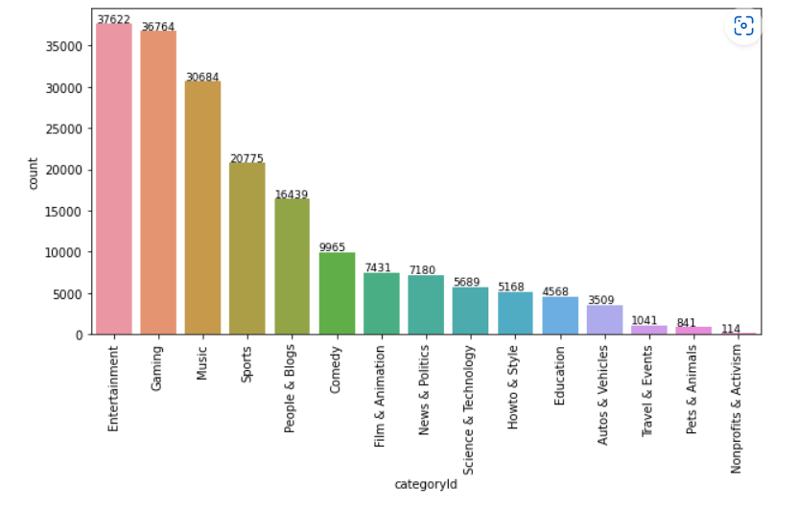
Research Questions
What makes a video trend for a longer time?
What would be the amount of time it takes for a video to get into the trending list?
What are the most used tags, optimal title length, and optimal day to post for the videos that trend?
Is toxicity on YouTube dominating positivity?

Slide 4
Research Paper – 1 Youtube Trending Video analysis by Dublin School
Overview
What is the state of the research paper?
Predicting the number of days the video will take to get on the trending list
Predicting the number of days the video will trend on the trending list
What is missing?
Making use of Video pictures in the model prediction
Making use of comments

Slide 5
Research Paper - 2 Identifying Latent Toxic Features on YouTube Using Non-negative Matrix Factorization
What is the state of the research paper?
Used the Non-negative Matrix Factorization based approach in the comments section to predict toxicity scores and assess toxicity on social media networks.
What is missing?
Did not assess positive comments.

Slide 6
Research Paper -3 Trending YouTube Video Analysis
What is the state of the research paper?
- Characteristics that determined a video to be trending across countries like:
Correlation between likes and views
Compare average hours taken to trend across different categories
Identify the most popular tags across the countries
Analysis of the title length’s range for a video to trend
Identify the pattern over days of the week which leads to the information about the optimal day to post the videos.
What is missing?
Analysis on how comments affect a video to be trending or not

Slide 7
Dataset
Source: 1
https://www.kaggle.com/datasets/rsrishav/youtube-trending-video-dataset
Columns: video id, title, channel title, publish time, tags, views, likes and dislikes, description, and comment count.
Rows: 2,00,000
The number of rows containing unique video ids: 35,000
Source: 2
YOUTUBE API
Columns: Video length, Comments

Slide 8
Kaggle Dataset
Youtube API
Final Dataset

Slide 9
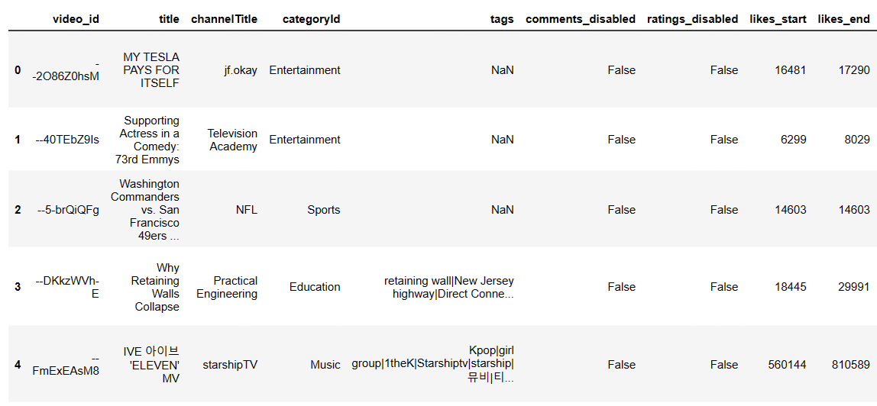
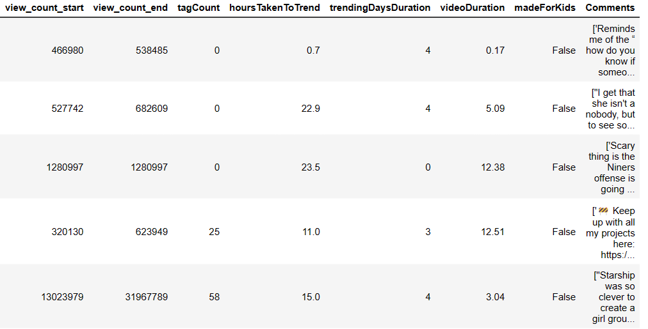
Dataframe

Slide 10
References
[1] Youtube Trending Video analysis by Dublin School, Niture, Aakash Ashok, January 11th, 2021
https://esource.dbs.ie/handle/10788/4260
[2] Identifying Latent Toxic Features on YouTube Using Non-negative Matrix Factorization, Adewale Obadimu, Esther Mead, Nitin Agarwal, October 2021
https://www.researchgate.net/publication/336568016_Identifying_Latent_Toxic_Features_on_YouTube_Using_Non-negative_Matrix_Factorization
[3] Trending YouTube Video Analysis, MD Sakibur Hasan, Bishal Sarker, Diksha Shrestha, Roshan Shrestha, Sajal N. Shrestha, February 7th, 2023
https://www.researchsquare.com/article/rs-2548456/v1
[4] Trending on YouTube
https://support.google.com/youtube/answer/7239739?hl=en

Slide 11
Thank You !!

